Slide 1
Quantitative Evidence for the Early Anthropogenic Hypothesis
Elise Reed Vincent Hall 570 July 21, 2015

Slide 2
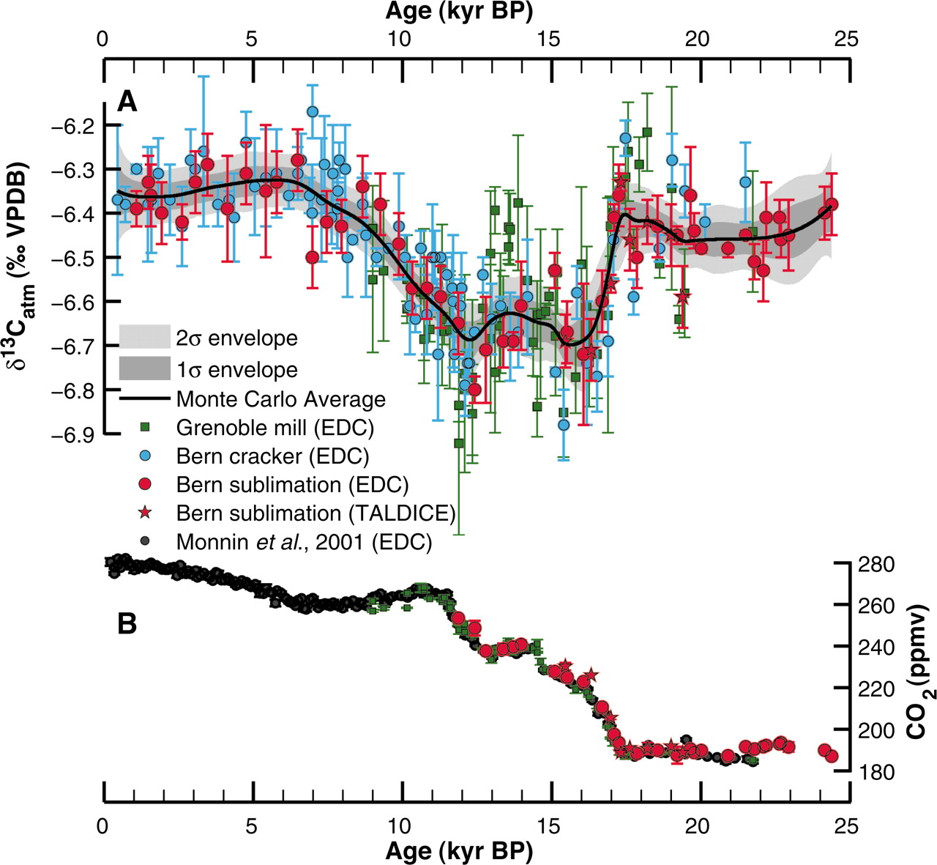
The Early Anthropogenic Hypothesis
Proposed by paleoclimatologist William Ruddiman in 2001
Contends that the Anthropocene began about 8,000 years ago, not in the 1800s as is widely agreed upon
Supported by the evidence of departure from regular Milankovitch cycle trends
Also supported by the timeline of development of human agriculture
Schmitt, et. al

Slide 3
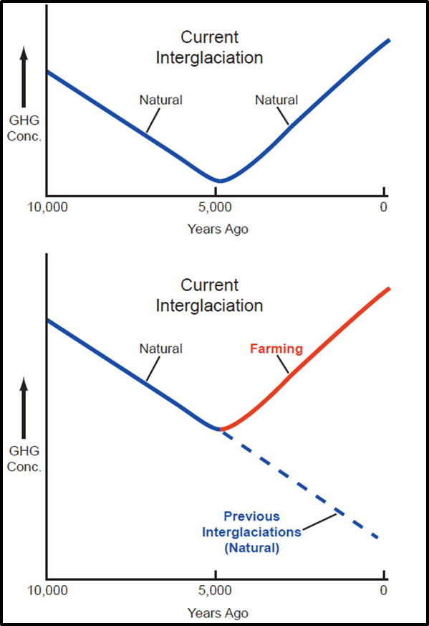
Cause of Deviation: Anthropogenically Induced Land Cover Change (ALCC)
Deforestation
Burning trees, or hacking trees and leaving them to decay, releases large amount of CO₂ from the terrestrial biosphere to the atmosphere
Primitive Agriculture
The agriculture practiced during the Neolithic Revolution was extremely inefficient
Practices included flooding large areas and overworking soil
It has also now been proposed that land use per person has not remained constant into the past; 8,000 years ago every person would use much more land than we each do today

Slide 4
The Industrial Era View
Estimates for ALCC depend only on population while assuming land use per person has remained constant over the last 8,000 years
Based on this assumption, anthropogenic land use is predicted to be negligible before 1500 AD
This implies that ALCC could not have been a contributing factor in the rise of CO₂ starting 8,000 years ago

Slide 5
The Alternative to the Industrial Era View
Field-based research does not support assuming constant per person land use
Instead it has shown that as population increases, per capita land use decreases
Over time, technology improves and with increasing population the amount of available land decreases
Kaplan, et. al has altered the Lund-Potsdam-Jena Dynamic Global Vegetation Model (LPJ DGVM) to handle the scenarios designed to quantify ALCC

Slide 6
Two Simulations
The HYDE 3.1 data base, published by Klein Goldewijk et. al in 2010, uses the assumption there is a near-linear relationship of population to land under anthropogenic use
The KK10 (Kaplan and Krumhardt 2010) scenario uses a new data base which has the main assumption that land use per capita, in general, has decreased over time

Slide 7
Total Land Under Anthropogenic Use

Slide 8
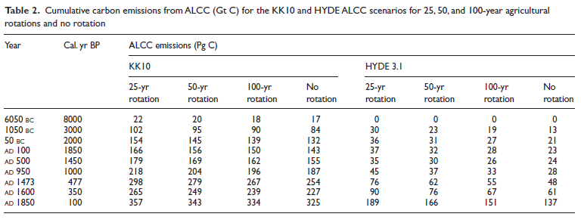
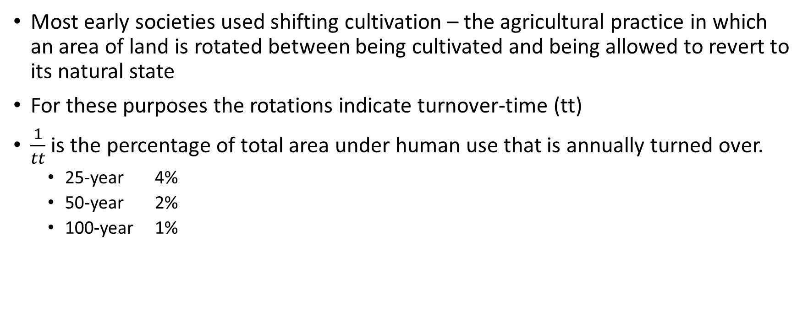
Incorporating Shifting Land Use Practices
Most early societies used shifting cultivation – the agricultural practice in which an area of land is rotated between being cultivated and being allowed to revert to its natural state
For these purposes the rotations indicate turnover-time (tt)
$\frac{1}{tt}$ is the percentage of total area under human use that is annually turned over.
25-year 4%
50-year 2%
100-year 1%

Slide 9
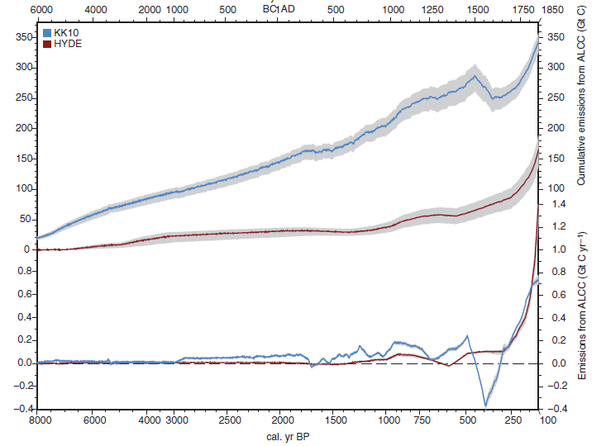
Cumulative Carbon Emissions and Annual Emissions

Slide 10
How does this support the Early Anthropogenic Hypothesis?
From Schmitt et. al’s ice core data we know there was a 15 ppm CO₂ increase in the atmosphere while trends in the Milankovitch cycles would predict a decrease in atmospheric CO₂
The KK10 scenario simulates emissions up to 102 PgC during this time period, which could have contributed to this rise in atmospheric carbon dioxide

Slide 11
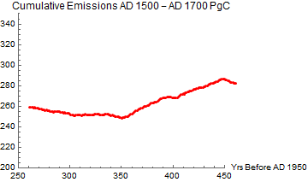
Another Interesting Period
10 ppm drop from AD 1500 to AD 1700
Most likely caused by land abandonment as a result of European contact with the Western Hemisphere
About a 40 PgC uptake is simulated in the KK10 scenario, explaining some of this change

Slide 12
Uncertainties and future possibilities
The two scenarios used produced vastly different estimates
Other estimates (Ruddiman and Ellis, 2009; Kaplan et. al, 2009) fall in the middle of these, leading to the idea that HYDE can be seen as a lower bound on anthropogenic effect while KK10 an upper bound
Cannot make direct comparison with ice core data – simulations do not include the effects of ocean chemistry, peatlands, and other elements
Gathering more data (especially for carbon sequestered in peatlands) and incorporating it into future simulations could give a more complete picture of the global carbon cycle over the last 8,000 years

Slide 13
Jed O. Kaplan, Kristen M. Krumhardt, Erle C. Ellis, William F. Ruddiman, Carsten Lemmen, and Kees Klein Goldewijk. “Holocene carbon emissions as a result of anthropogenic land cover change.” The Holocene (2010). Web.
Ruddiman, W.F. Earth’s Climate: Past and Future. New York: W.H. Freeman, 2001. Print.
Ruddiman, William F. “The Anthropogenic Greenhouse Era Began thousands of Years Ago”. Climate Change. 61.3(2003). 261-293. Springer Link. Web.
Schmitt, J., R. Schneider, J. Elsig, D. Leuenberger, A. Lourantou, J. Chappellaz, P. Kohler, F. Joos, T. F. Stocker, M. Leuenberger, and H. Fischer. "Carbon Isotope Constraints on the Deglacial CO2 Rise from Ice Cores." Science (2012): 711-14. Web.

